Slide 1

Capstone Project
LOAN DEFAULTERS PREDICTION
XYZ .Corp.Ltd
Batch - DSP 39
Group - 3

Slide 2

Participants
1. Sheryl Philip Kurien
2. Varsha Chapade
3. Vaibhav Sohla
4. Tanmay Jog

Slide 3
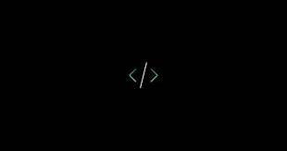
Problem Statement
Managing credit risk by using the past data to build a data model to predict the probability of default.
Alternatively, using a modelling technique which gives a binary output.
The main objective is to build a model that can predict the probability of the defaulter and non-defaulter by applying varying ML algorithms that will help the XYZ Corp to decide whether to pass the loan to that applicant or not.

Slide 4
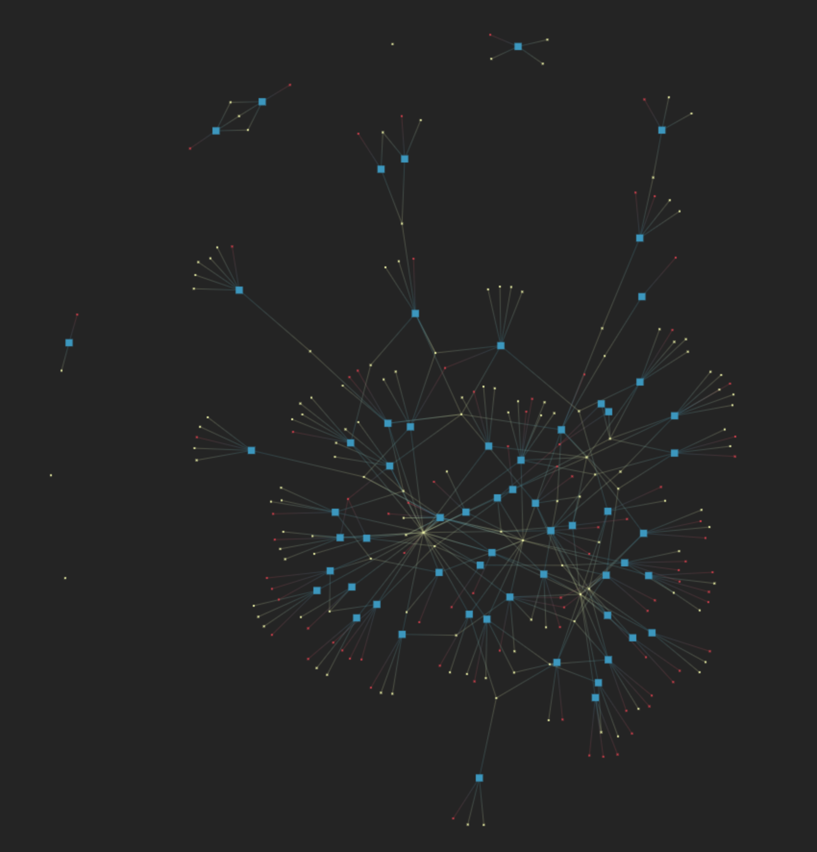
Data Description
This dataset given is about the loan issued by XYZ Corp from the year June, 2007 to December, 2015.
Dimension of the data: 73 variables and 855969 observations.
29 variables with missing values.
Dataset contains multiple data types like integer , object and float.
The dependent variable on which the model is based on is default_ind which has two classes 0 & 1, where 0 indicates non-defaulter and 1 indicates defaulter.
Predictor variables : loan_amnt, int_rate, annual_inc, mths_since_last_delinq, last_pymnt_amnt etc.

Slide 5

Softwares Used
There is a broad standard of libraries
Data Visualisation
Free and open source
It can take up large amount of data
PYTHON
TABLEAU
Easy to read and write codes
Easy to access from different sources
Provides interfaces to all commercial database
Easy Implementation

Slide 6
Libraries
Pandas
Numpy
Seaborn
Matplotlib.pyplot
Datetime
LabelEncoder
StandardScaler
sklearn.model_selection
sklearn.metrics
xgboost
sklearn.ensemble
sklearn.linear_model
sklearn.tree

Slide 7

DATA VISUALIZATION

Slide 8
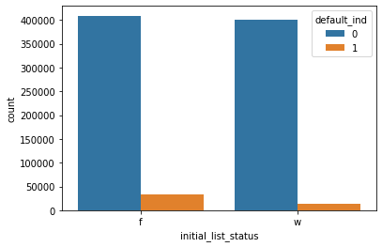
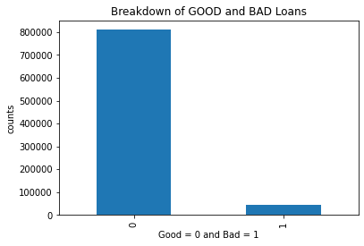
Data Visualization (1/4)
Breakdown of Good and Bad Loans
Initial Listing Status of Good and Bad Loans

Slide 9
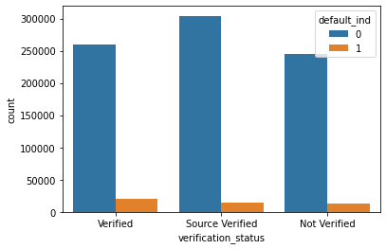
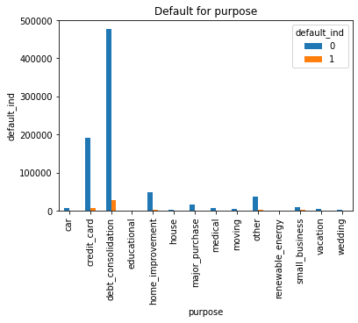
Data Visualization (2/4)
Status of Loan Default by Verification Status
Default for Purpose

Slide 10
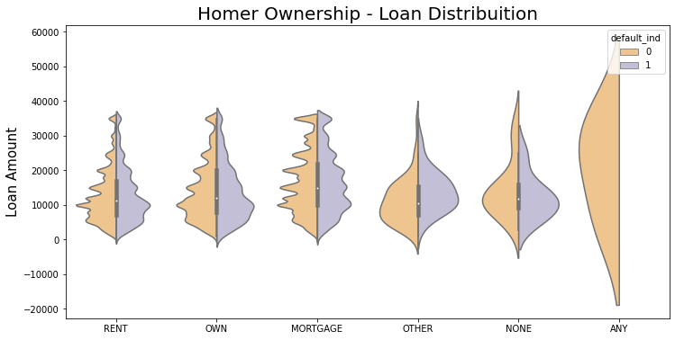
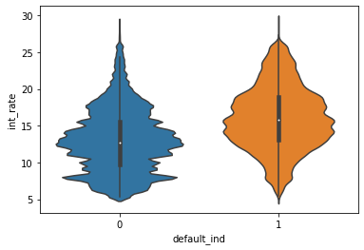
Data Visualization (3/4)
Home Ownership - Loan Distribution
Distribution of GOOD and BAD Loans by Interest Rate

Slide 11
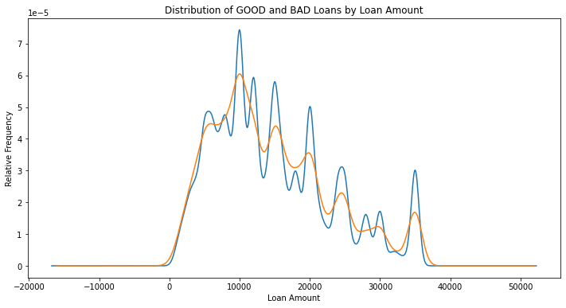
Data Visualization (4/4)
Distribution of Good and Bad Loan by Loan Amount

Slide 12

TABLEAU VISUALIZATION

Slide 13
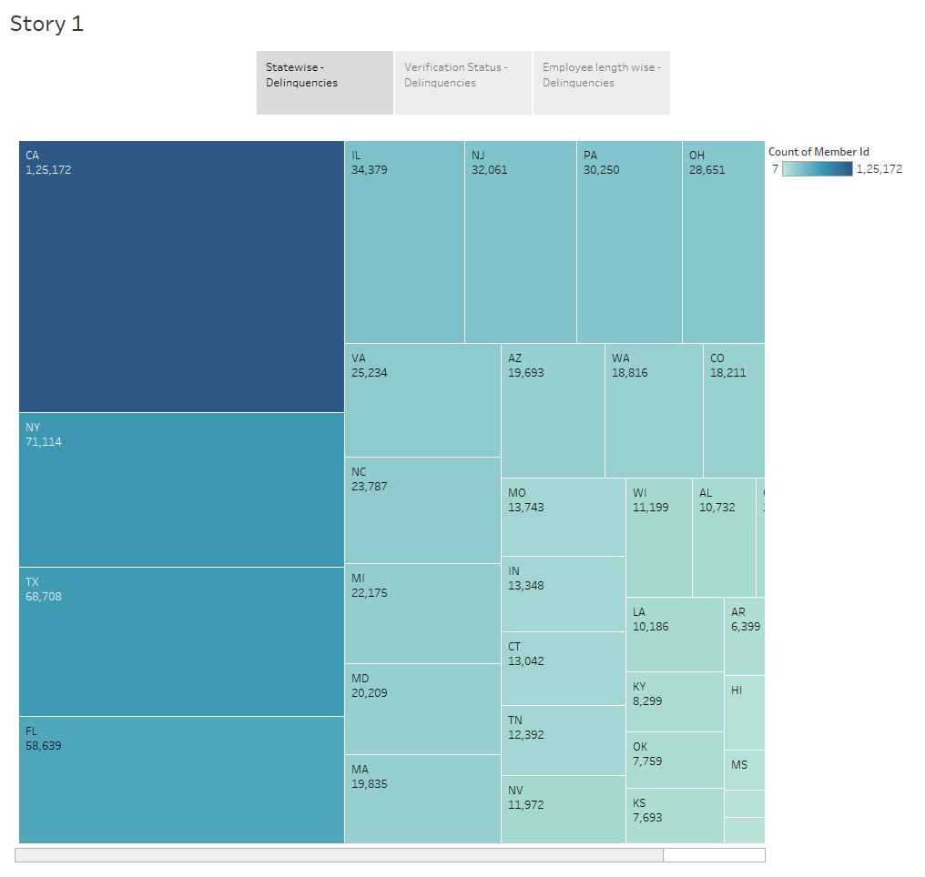

Slide 14
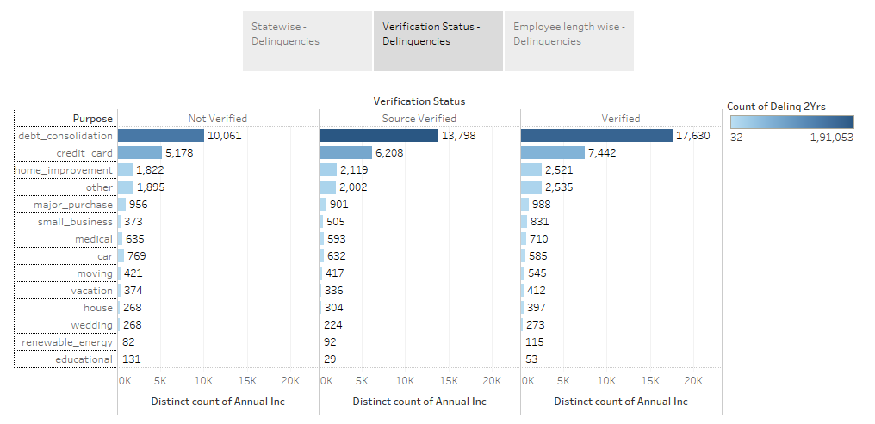

Slide 15
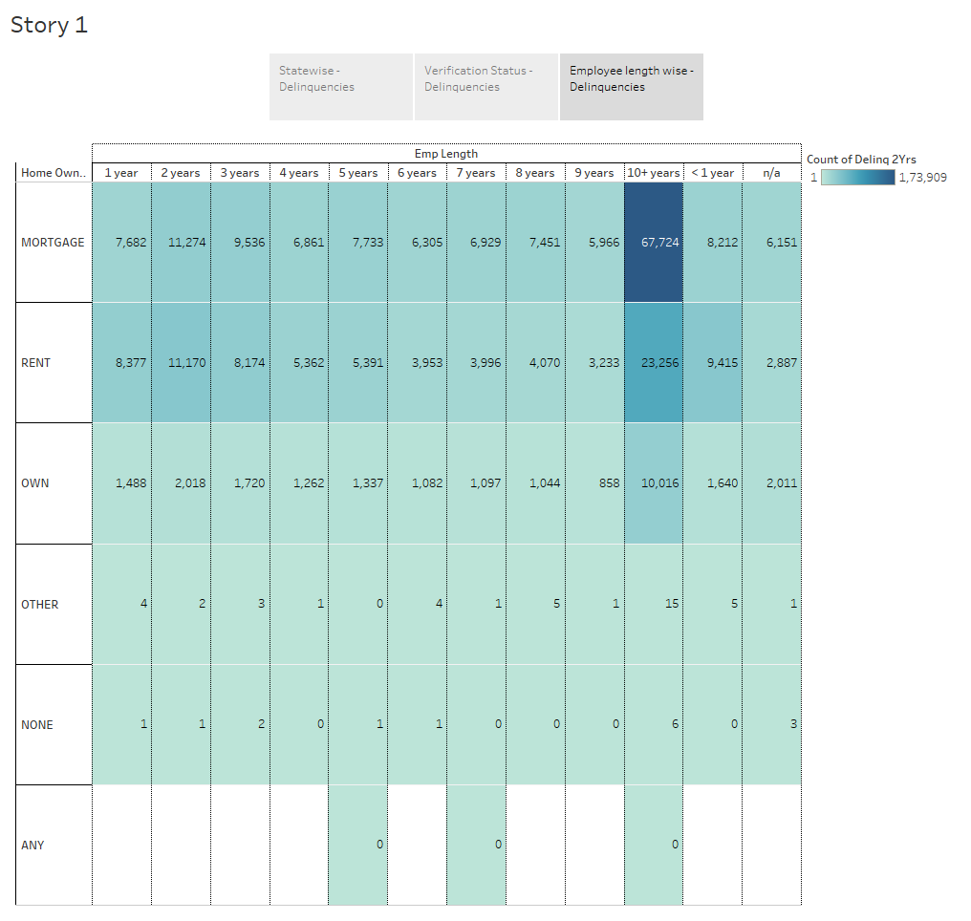

Slide 16

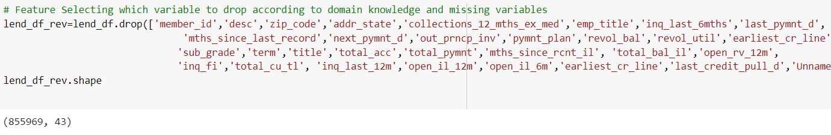
Feature Engineering(½)
Eliminating some variables according to domain knowledge .

Slide 17
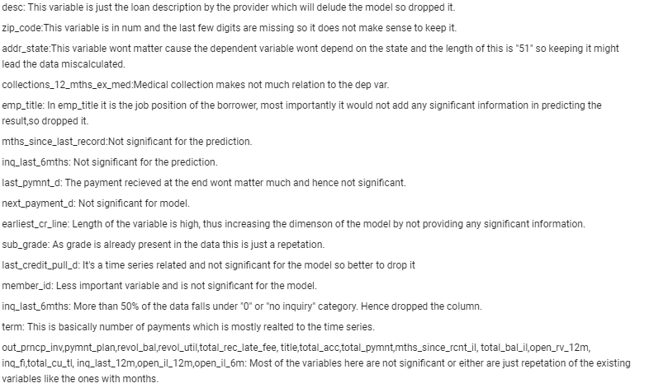
Feature Engineering(2/2)

Slide 18
Pre-Processing(⅓)
Dataset analyzed for any missing values.
Numerical/Date-Time variables and Categorical variables were separated.
Missing values were filled for variables -
Numerical : Missing values imputed with the Mean.
Categorical : Missing values imputed with the Mode.
Correlation of default_ind checked with important predictor variables.

Slide 19
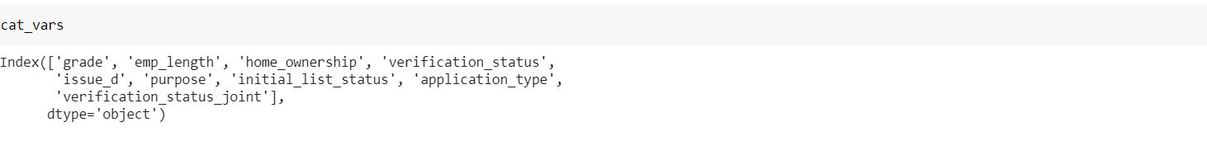
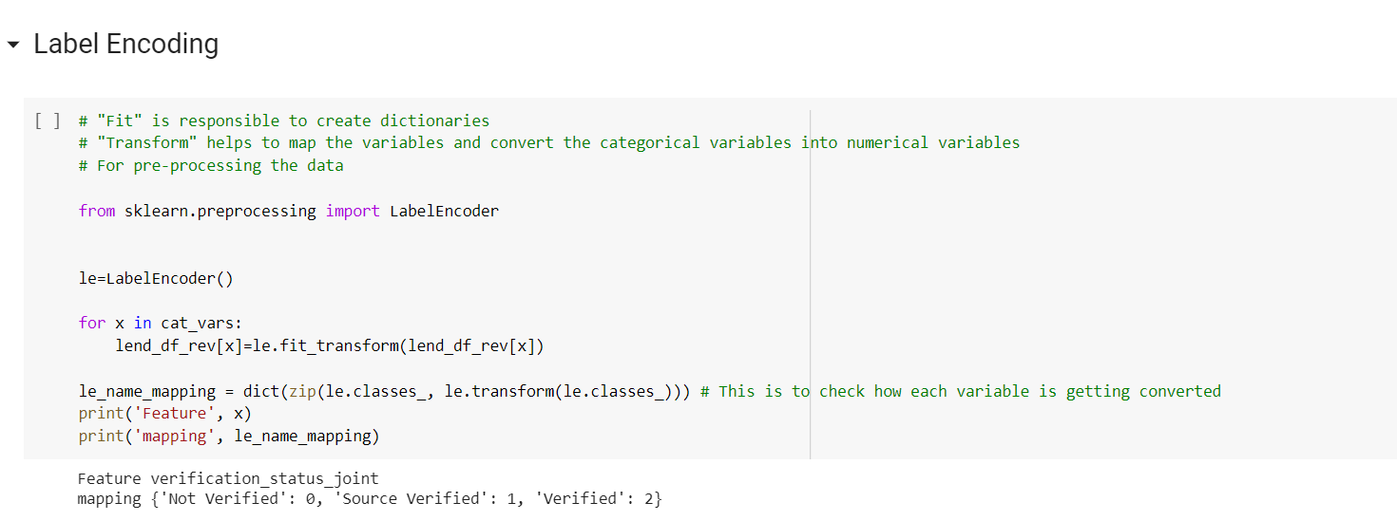
Pre-Processing(⅔)
Label Encoding:-
The categorical variables under the name of “cat_vars” to convert the object data into numerical category in order to use classification model. LabelEncoder used to create dictionaries and map the categorical variables into numerical variables.

Slide 20
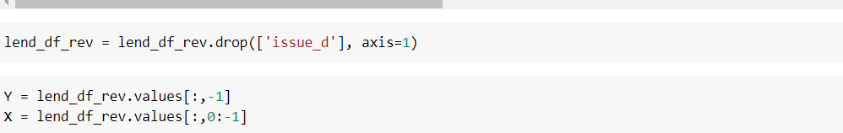
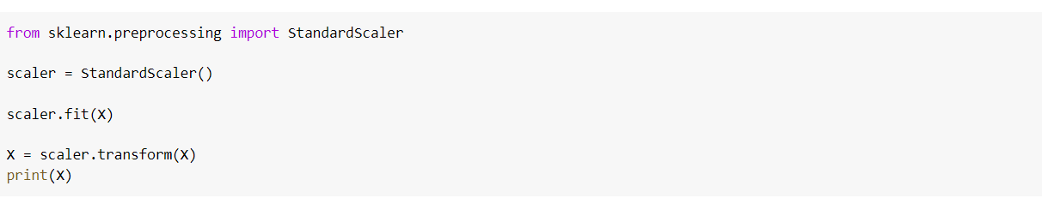
Pre-Processing(3/3)
Scaling the data:-
Scaling or standardization will help to transform the data such that the distribution will have a mean value 0 and standard deviation of 1. It will help to normalize the data if the range of the variables are far off from each other. It is mostly applied on the independent variables.

Slide 21

MODEL BUILDING

Slide 22
Splitting the Data
Train and Test Split
Data split on the basis of issue_d variable.
Train data : June, 2007 to May, 2015
Test data : June, 2015 to December, 2015

Slide 23
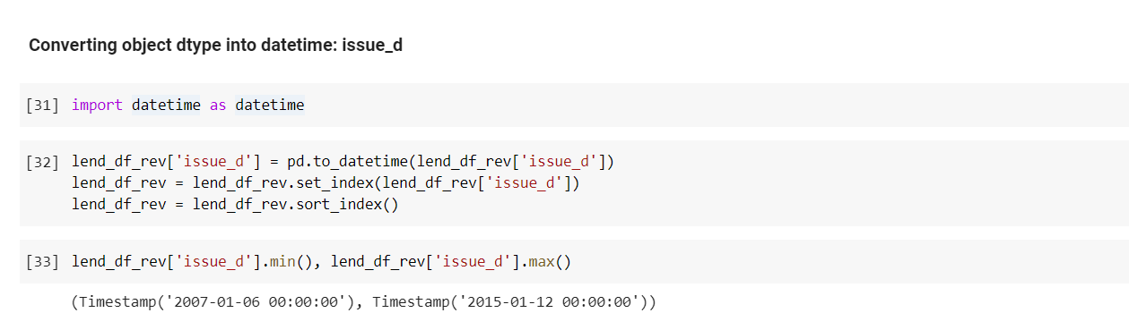
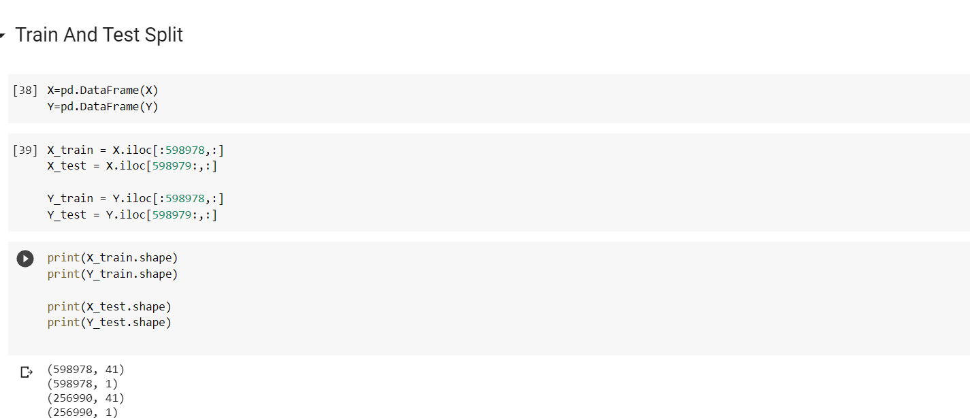
Train and Test Split

Slide 24
Models employed in the Project
Logistic Regression
XGBoost Algorithm
Decision Trees
Random Forest Classifier

Slide 25
Logistic Regression
Supervised learning classification algorithm.
Intended for binary classification problems.
Predicts the probability of an instance belonging to the default class.
Uses a sigmoid function to convert the values into a range of 0 to 1.

Slide 26
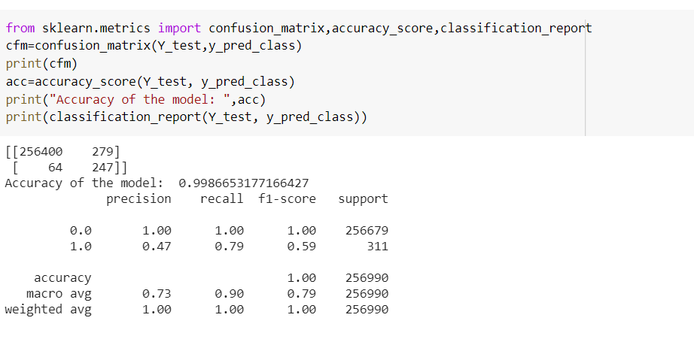
Tuned Logistic Regression Model
The model with adjusting the threshold to 0.60 is giving the best accuracy of 99.86%

Slide 27
XGBoost Algorithm
Supervised learning classification algorithm.
XGBoost is an “ensemble learning” method.
Attempts to accurately predict a target variable by combining the estimates of a set of simpler, weaker models.
Called Gradient Boosting as it uses a gradient descent algorithm to minimize the loss when adding new models.
Has in-built Cross Validation and takes care of outliers upto some extent.

Slide 28

Random Forest Classifier
Supervised learning classification algorithm.
Used for Classification & Regression.
The "forest", is an ensemble of decision trees.
Only a random subset of the features is taken into consideration for splitting a node.
Low correlation between the ensemble trees is the key to to the model performing better.

Slide 29
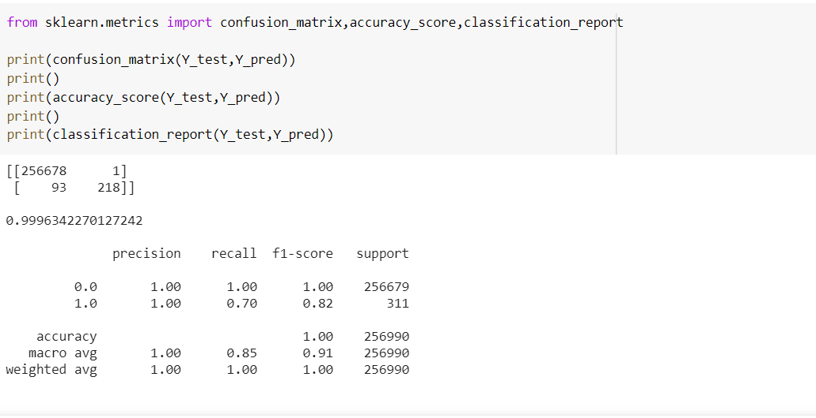
Random Forest Evaluation Matrix

Slide 30
Decision Trees (Best Model)
Supervised learning classification algorithm.
Used for Classification & Regression.
Builds a tree by splitting the data into homogenous datasets.
The tree can be explained by two entities-
Decision nodes : Where the data is split
Leaves : Decisions or the final outcomes

Slide 31

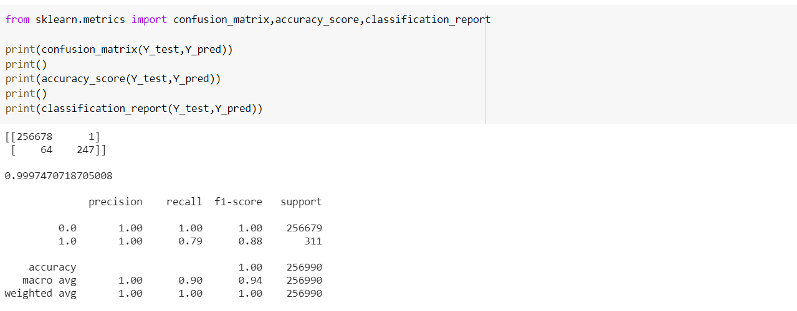
Decision Tree Evaluation Matrix

Slide 32
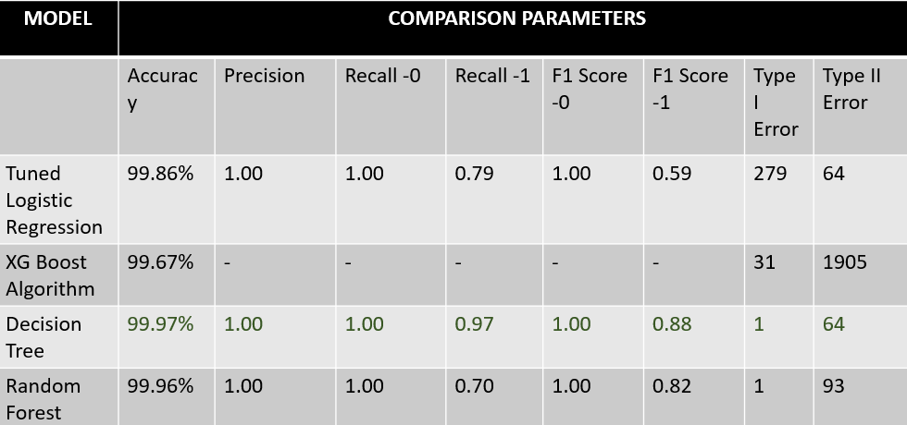
Comparison of Models

Slide 33
Business Inference
Applicants taking loan for debt consolidation have the highest probability of paying it off.
Banks should consider "Grade" as a major variable while providing loans.
Annual income increases the probability that the person will default depending on the salary bracket.
Interest rate can highly impact the probability to default.
Banks should consider minimising the interest rate for self employed applicants and for those having experience < 1 year.

Slide 34
Conclusion
We have successfully built a machine learning algorithm to predict the people who might default on their loans.
The models produce varying degrees of predictive powers, with Decision Tree performing best accuracy with about 99.97% and the second best is Random Forest with about 99.96%

Slide 35


